Slide 1
Big Mountain Resort
Cost Proposal
February 7, 2021

Slide 2
Understanding the problem
Premium Rates
Amenities
Facilities Optimization
Common Resorts (<$70):
$ 55-57/person
Premium Resorts: (>$75):
$80/person with
highest at $90/person
Big Mountain:
$81.00/ person
access to 105 trails
11 lifts
1 recently added chair lift
2 T-Bars
Longest run at 3.3 mi
Skiable terrain of 3000 ac
Cannot determine popular facilities solely from the average market price

Slide 3
Project objective:
Cut operational costs by 5% less than the average market costs without undermining the current ticket price OR optimize facilities usage and supporting a ticket price increase of 5%

Slide 4
Key Findings and Recommendations
150ft vertical drop increase to lower point
Install 1 chair lift to bring skiers back up
Closing down the least used ski runs:
Closing 1 run does not change the price of the ticket
Big Mountain can raise 5-day ticket price by $8.61 from $81.00 to $89.61
Additional profit: ~$150.6 mil; 10% increase

Slide 5
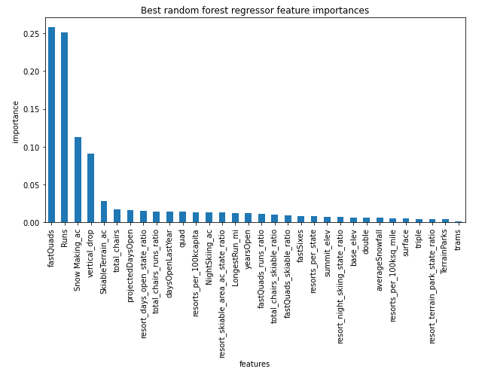
Model Results and Analysis
Important Features
Visitors are drawn to:
Number of fast quads
Number of runs
Snow Making/Snow Guarantee
Vertical Drop
Big Mountain dominates market when it comes to snow making and fast quads

Slide 6
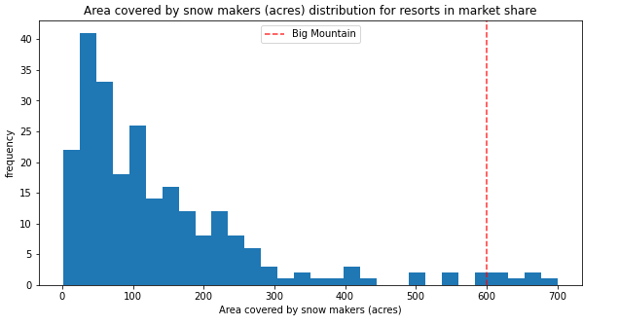
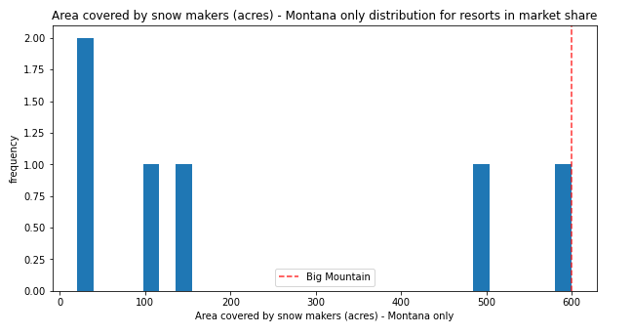
Model Results and Analysis: Snow Makers
Montana Only
Additional snow making equipment does not change the price significantly from the recommendation
All Resorts
Narrowing down the market solely to the state of Montana, the key features are in highest league of the table

Slide 7
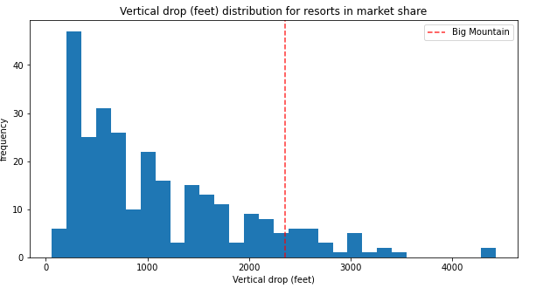
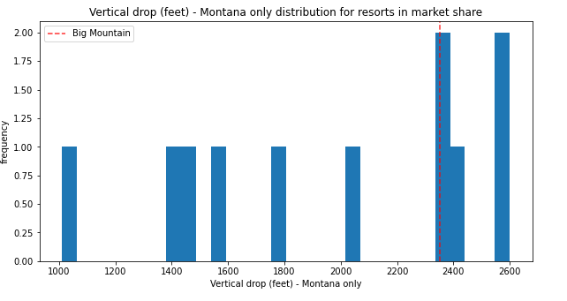
Model Results and Analysis: Vertical Drop
All Resorts
Montana Only
Shows room for additional increase in vertical drop to dominate both markets

Slide 8
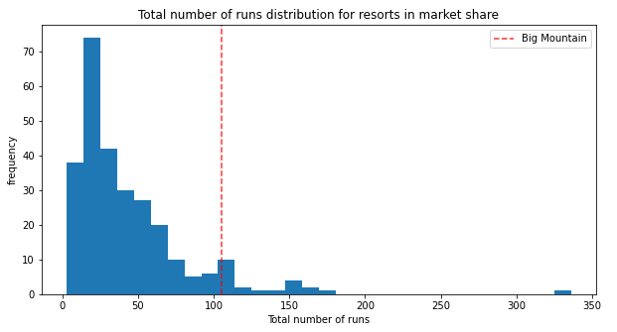
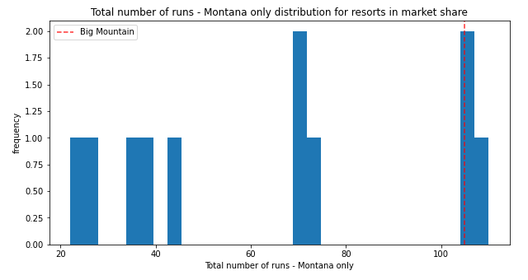
Model Results and Analysis: Number of Runs
All Resorts
Montana Only
The resort has one of the most runs. Reducing 1 run will not reduce competitiveness in the market or affect pricing

Slide 9
Conclusion
10% increase in ticket price
Determine operational costs to refine ticket pricing
Knowing the most popular features for visitors, Big Mountain can explore other parameters:
Increasing vertical drop
Increase snow making acres
Gain/Loss of closing more runs

